Slide 1
News Article Classification Supervised Prediction of Text Subject Matter Categories from Words
Rosalie Day – Final Report, Capstone 2 - March 2020
Springboard, Data Science Career Track Curriculum

Slide 2
Natural language processing - ubiquitous in the internet and the IOT universe Can we glean what it means for future composition?
Purpose-
Inform public policy: Simple best performing methods
Information: Which words and frequencies of use
Generalizable approaches?

Slide 3
The DATA – BBC News Articles on Kaggle website 5 categories of content Sample size: 2126 unique articles
The Models – Supervised classifiers from Scikit-Learn 2 extraction methods Tuned or are defaults sufficient for corpus and use?

Slide 4
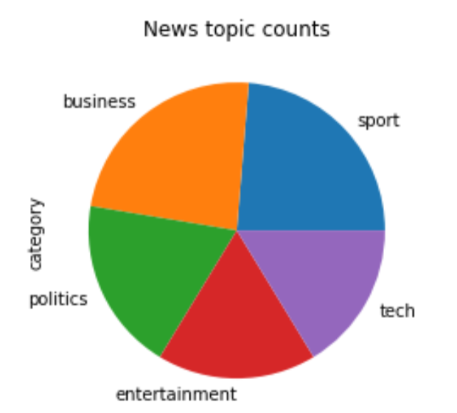
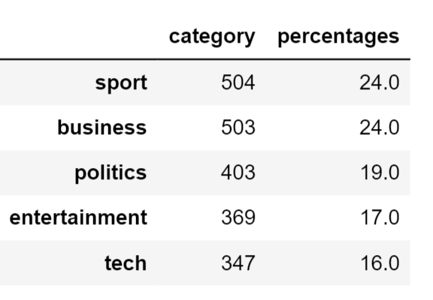
News article texts -
Downloaded to Pandas
Special characters removed
Standard (NLTK) stopwords removed
Article subject categories

Slide 5
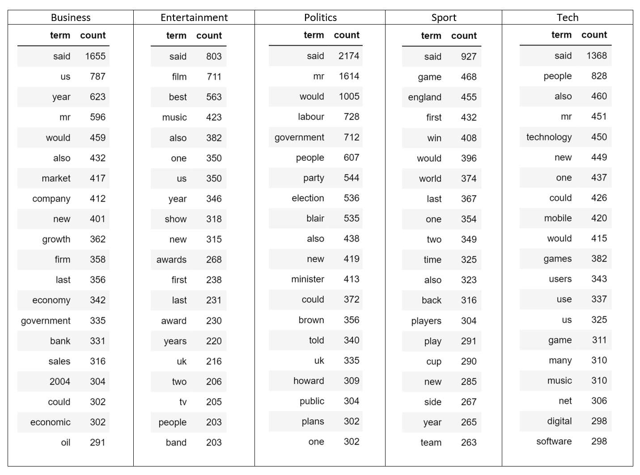
Most Common Words by Category

Slide 6
Text Data Preparation for Classification Models -Tokens extracted and vectorized (converted to numeric coding) -Two extraction methods used
Outputs –
“Bag of Words,” word counts for entire body of texts, “corpus;”
‘TF-IDF” - Term Frequency-Inverse Document Frequency
- words weighted for importance

Slide 7
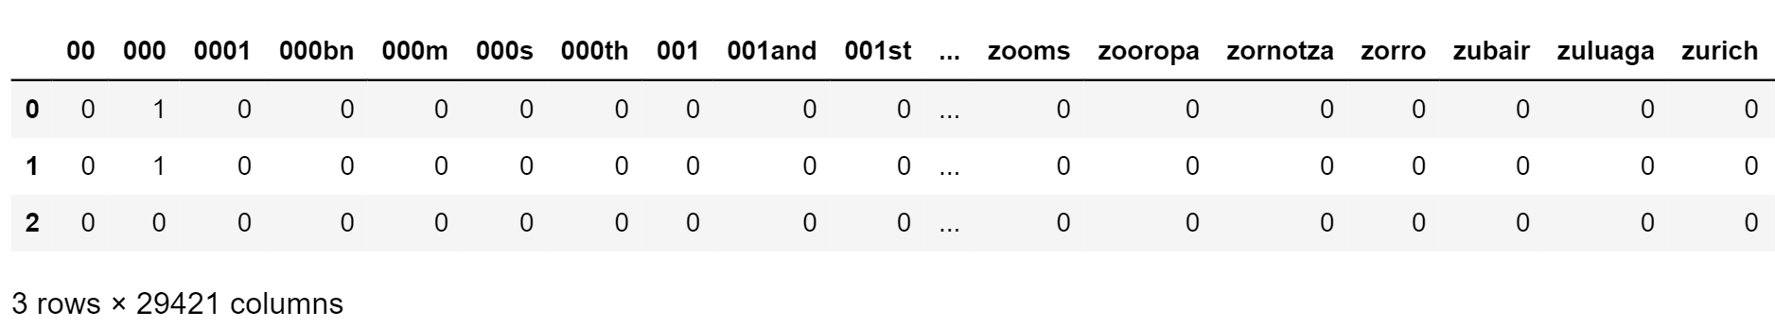
BAG OF WORDS CountVectorizer extractor from Scikit-Learn - - words pooled with no use or sequence information - creates a feature for each token - single word tokens - a la default setting, "ngram_range; default=(1, 1)” Transformed output – columns: vocabulary of 29,241 words (“features” in models) rows: 2,126 articles and cells: count Glimpse of the Document-Term Matrix

Slide 8
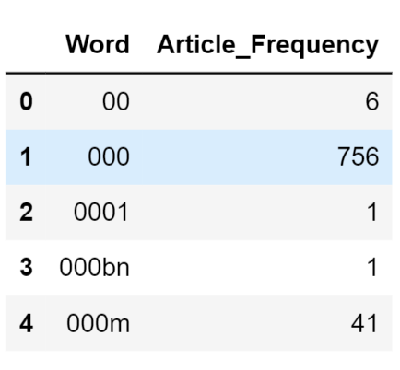
BAG OF WORDS
Word-Document Frequency Table
Unique numeric code for unique word
Frequency column is the sum of every column from Document-Term Matrix (in previous slide)
Word coded “000” occurs 756 times

Slide 9
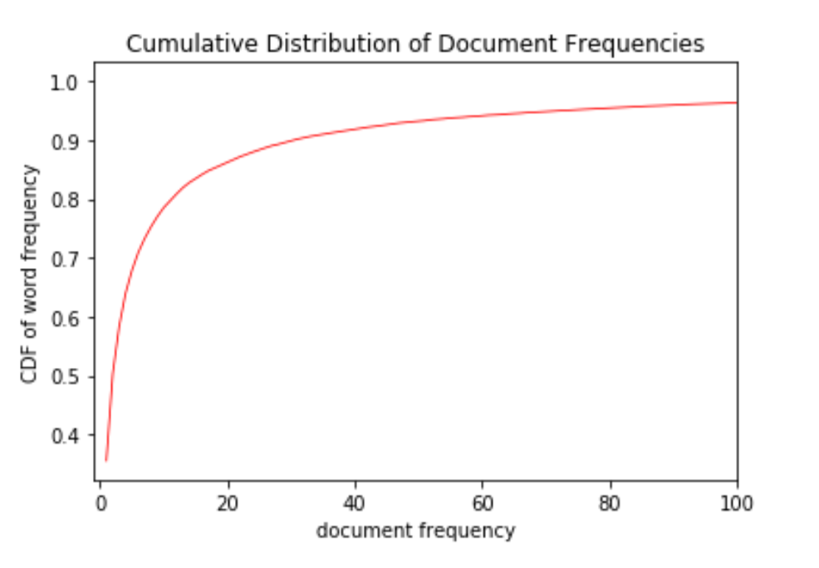
BAG OF WORDS Intuitive parameter for tuning in CountVectorizer extractor -- minimum occurrence of the term - “min_df," or the cut-off default is one time (min_df = 1).
Cumulative distribution of word frequencies by number of documents, the minimum probably is greater than one. Fitted and transformed text with (min_df= 2).
Reduces total number of features to 17240

Slide 10
CLASSIFICATION Supervised machine learning classification models “labeled” features have corresponding article category – training ⬄ learning
K-Nearest Neighbors (KNN)
Logistic Regression
Random Forest
Gradient Boosting
Naïve Bayes (multinomial)
Scikit-Learn’s default parameters
Bag of Words data split randomly
70 : 30, training : testing ratio
- used throughout analysis
Generally good performance,
- - at least 94% accuracy in three models
(according weighted f1-score)

Slide 11
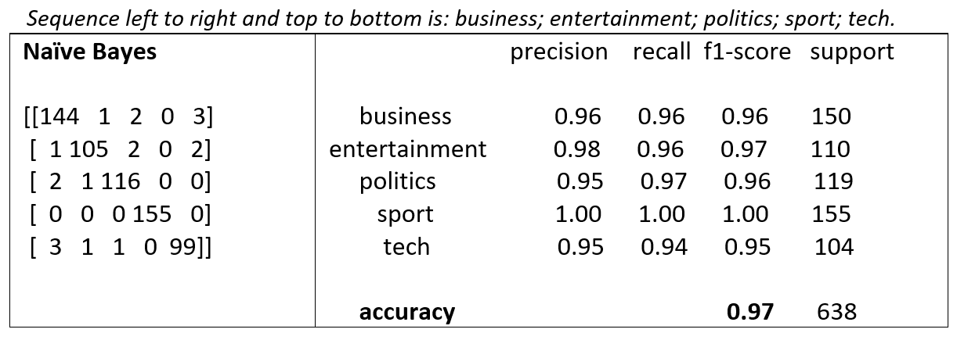
CLASSIFICATION Performance metrics - per model trained and tested on Bag of Words data Calculated and displayed scores in Classification reports Confusion matrices - detailed summaries of how models classified on the news categories correctly (true positives and negatives) or incorrectly (false positives and negatives). Best performing model- Naïve Bayes, .97 percent accurate predicting categories on test data

Slide 12
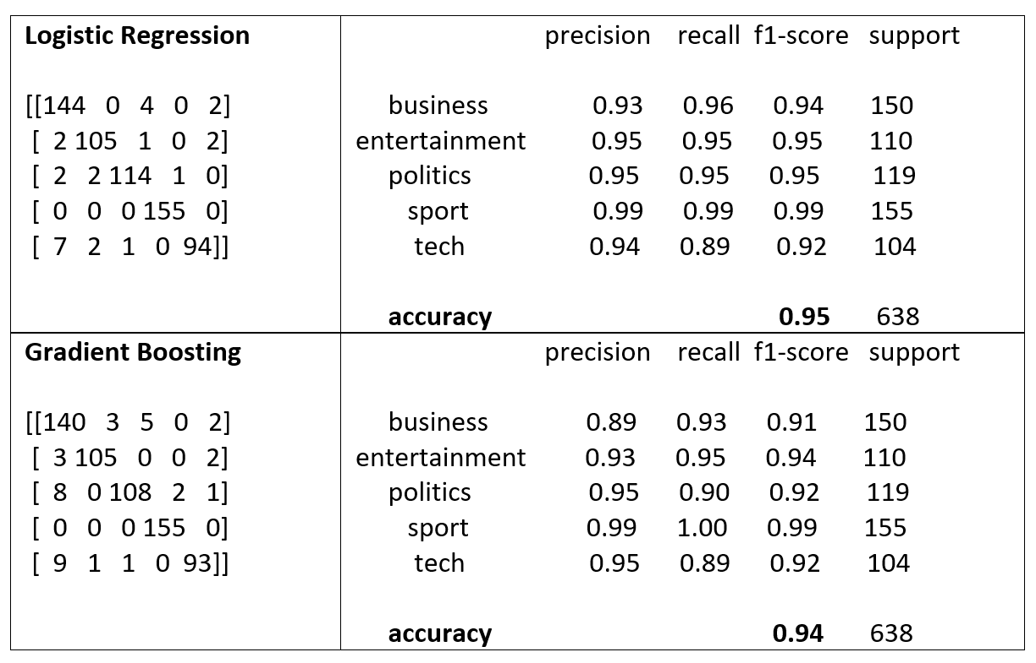
CLASSIFICATION Performances of the near best – Logistic Regression and Gradient Boosting

Slide 13
CLASSIFICATION Performances of the near best – Logistic Regression and Gradient Boosting

Slide 14
Is Logistic Regression, at second best, accuracy 0.95, an opportunity for parameter tuning? Optimizing regularization parameter, "C," default = 1.
GridSearchCV - with alternative values and the default
Cross validation partitioned the training data into fifths, withholding a partition for testing, and running every combination of the remaining 4 partitions.
Default parameter scored best (0.967 out of 1) – no tuning required

Slide 15
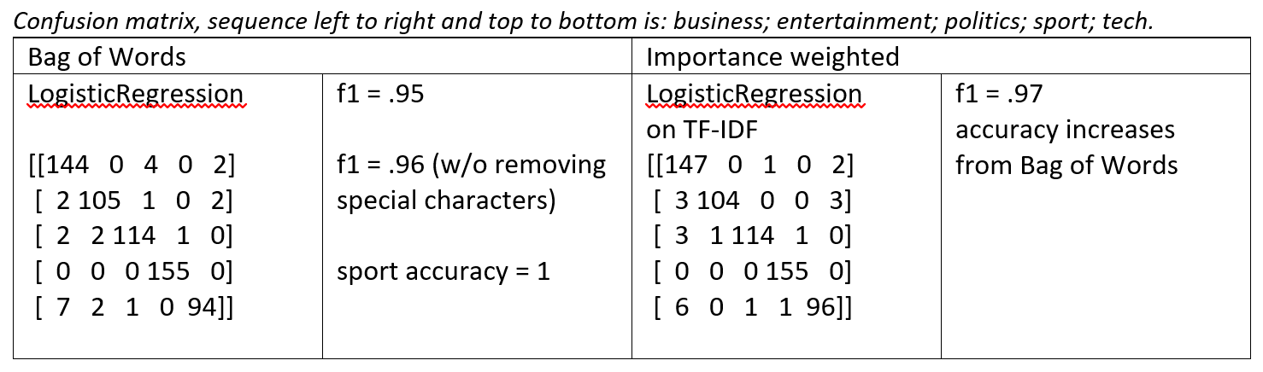
TF-IDF and CLASSIFICATION Classification models on TF-IDF ("term importance") input – 3 best performing models: Naive Bayes; Logistic Regression; Gradient Boosting TF-IDF feature extraction calculates relative importance with term document frequency weighted by term frequency in the corpus Logistic Regression predicts categories best on TF-IDF and best average score of models

Slide 16
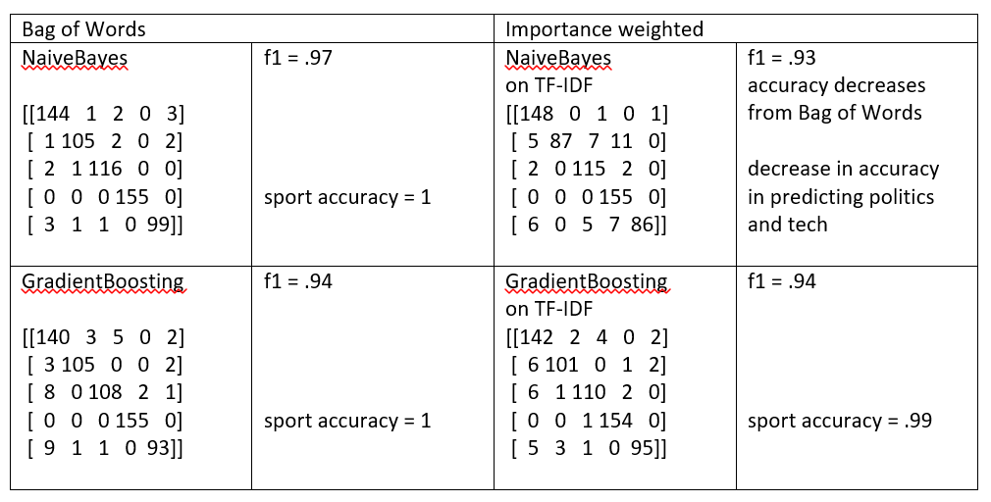
EXTRACTION and CLASSIFICATION Two near best classification models fitted and predicted on two extractions of features.

Slide 17
These classification models, with default parameters, classified articles associated with the five categories better than nine out of ten times and showed very little sensitivity to the method of features extraction.
Logistic Regression classifier performed at average accuracy of .96 Naïve Bayes averaged .95 Gradient Boosting remained the same at .94.
More analysis
Performance of unsupervised models, cluster analysis and principal component analysis, would be interesting for comparison.

